Slide 1

Effectiveness of using Microsoft Teams in Online Learning
May Thet Htar Aung
Batch 67
Info Myanmar University
Unit 13: Computing Research project

Slide 2
Contents
Introduction
Background
Aim and Objectives
Time Plan
Research Methodologies
Research Design
Survey Questions
Survey Analysis Outcomes
Conclusion

Slide 3
Introduction
Remote work(RW) is work done outside of the control of work.
It is also known as working from home or telecommuting.
It is when employees can successfully execute projects and daily tasks without needing to commute to an office each day.
Different types of RW are fully remote employees, Flexible jobs and freelancers.
In this research, the title is “The Effectiveness of using Microsoft Teams in Online Learning”

Slide 4
Background
The mainly research project background investigating and analyzing tips and features of Microsoft Teams
Teams and Channels
Conversation within channels and teams
A chat Function
Document storage in share Point
Online video calling and screen sharing
Online meetings
Audio conferencing

Slide 5
Aim Objectives
This project is aimed to know the usage of the Microsoft Teams App for online learning by students and educators.
In this pandemic situation, most of the students are running the routine daily work based on the online.
Just want to observe the finding that the Microsoft Teams app has various kinds of features and functions that are effective for the student in remote learning.
To know from distance education to the online education
To give the information on remote learning area
To investigate the features and function of the Microsoft Teams application
To know the information on how effective Microsoft Teams application for online learning students
To evaluate the strength and weaknesses of Microsoft Teams in the remote learning area.

Slide 6
Time Plan
No | Activity | Estimated Duration | Predecessor
1 | Project Initiation | 20days
1.1 | Research the Remote working area | 5days
1.2 | Choosing the title that related RW area | 3days | 1.1
1.3 | Research the other literature that related title | 10days | 1.2
1.4 | Do the literature review | 12days
2 | Project Planning | 15days
2.1 | Define Research Proposal | 3days | 1.4
2.2 | Draw Work Breakdown Structure | 2days | 2.1
2.3 | Define Time Estimate | 5days | 2.2
2.4 | Draw Gantt Chart | 5days | 2.3
3 | Examining | 13days
3.1 | Download the application | 1day | 2.4
3.2 | Using/Testing the app features | 6days | 3.1
3.3 | Evaluate the pros and cons of this application | 6days | 3.2
4 | Data Analysis and Evaluate | 25days
4.1 | Prepare Survey Question | 5days | 3.3
4.2 | Delivery and collect Survey Form | 10days | 4.1
4.3 | Analysis the data from the Survey | 5days | 4.2
4.4 | Evaluate the result | 5days | 4.3
5 | Completing the project | 15days
5.1 | Project presentation | 5days | 4.4
5.2 | Report project | 6days | 5.1
5.3 | Closing the project | 4days | 5.2
Total Effort Days |  | 88 days
Milestone one: After the project Planning Test
Target date (set by the tutor):30.5.2022
Milestone two: After the Data Analysis Test
Target date (set by the tutor):4.7.2022
Milestone three: After evaluating the pros and cons of this application test
Target date (set by the tutor): 25.7.2022

Slide 7
Research Methodology
This research is primary research. It is defined as a methodology used by researchers to collect data directly, rather than depending on data collected from previously done research.
This project research approach is inductive.
Inductive research entails looking for patterns in observations and formulating explanations – theories – for those patterns using a sequence of hypotheses.
Use a mixed data collection method for survey research in this project.
Have to use Quantitative research and Qualitative research questions.

Slide 8
Research Design
Hypothesis
The Microsoft Teams have good features which can have positive effects on students in remote working
Number of Respondents
I need to collect data from about 50 people.
Roles of Respondents
I survey HND students and some of my friends from the IT environments using the convenience non-probability sampling method.
Analytical Tools and Techniques
Frequency Distribution analysis model generated from Google Form analytical tool
Descriptive statistics and Regression analysis models in Excel analytical tool

Slide 9
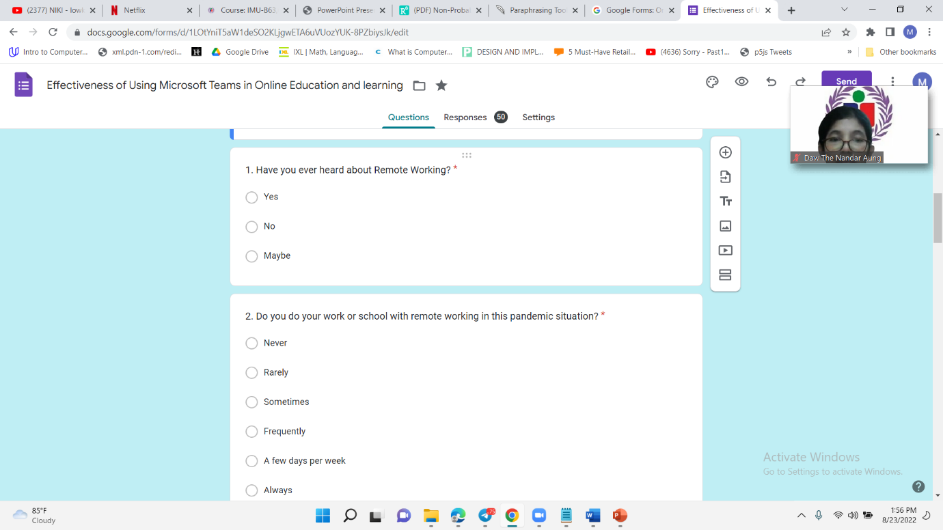
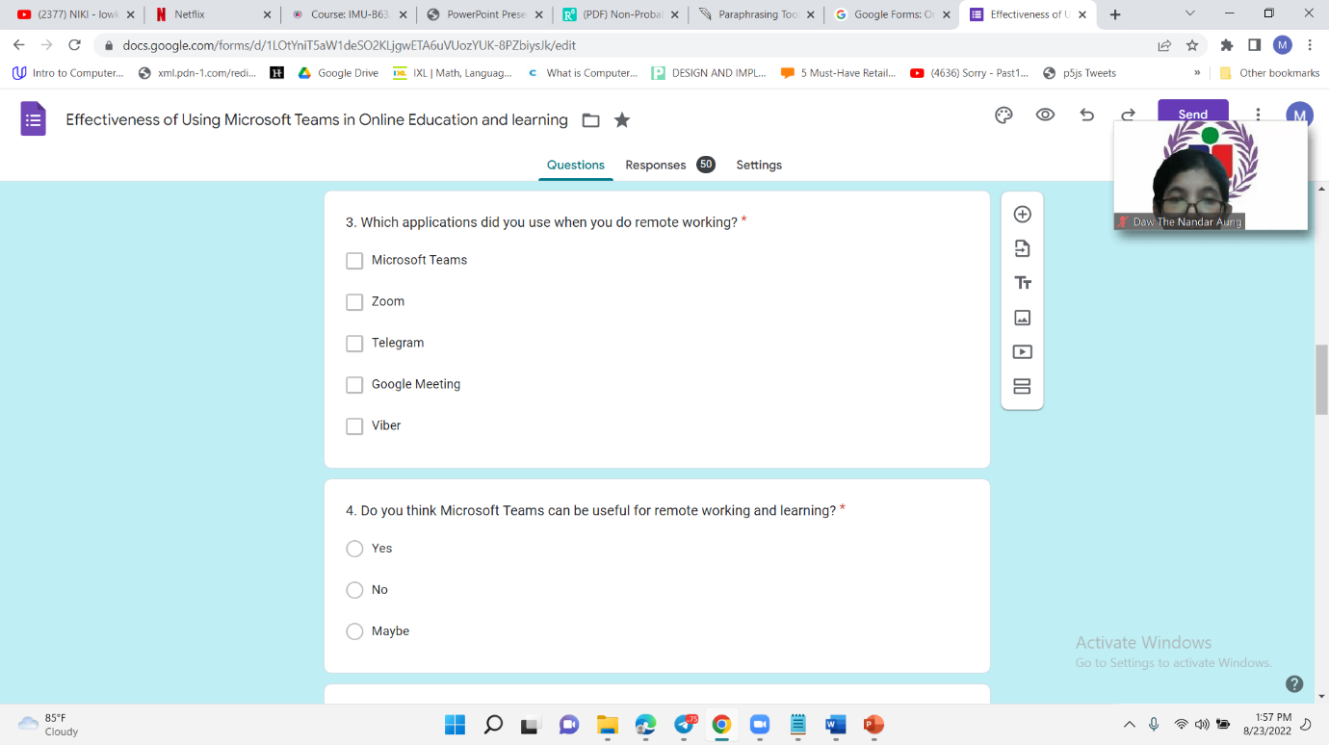
Survey Questions
Survey Questions 1 to 4

Slide 10
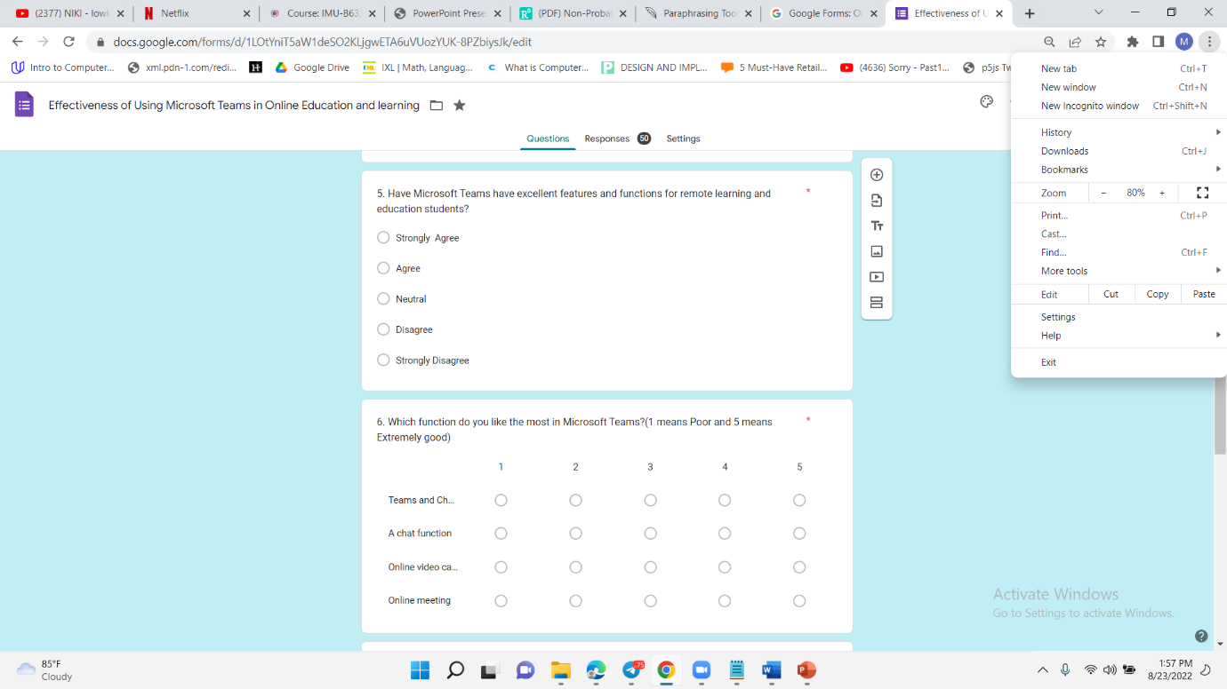
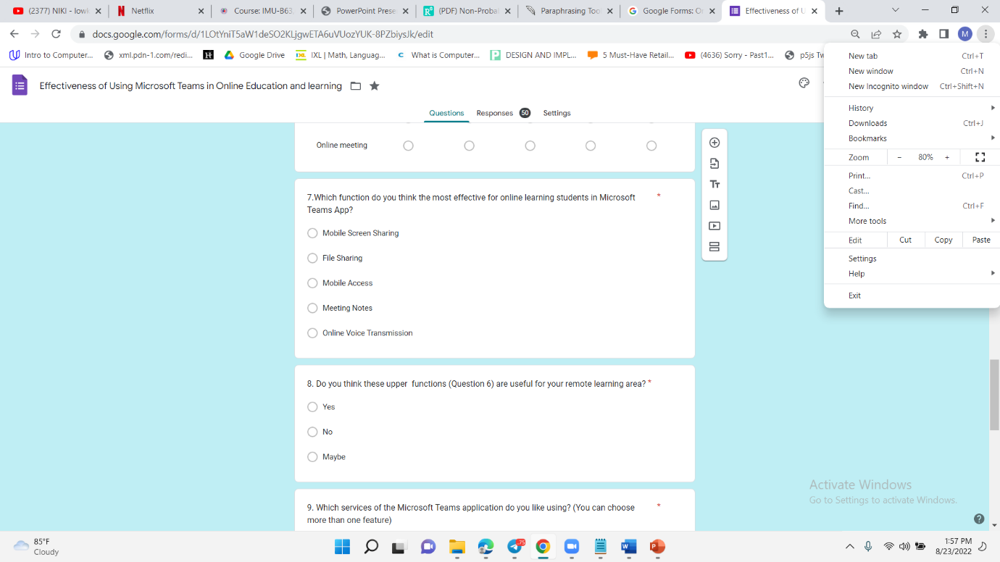
Survey Questions
Survey Questions 5 to 8

Slide 11
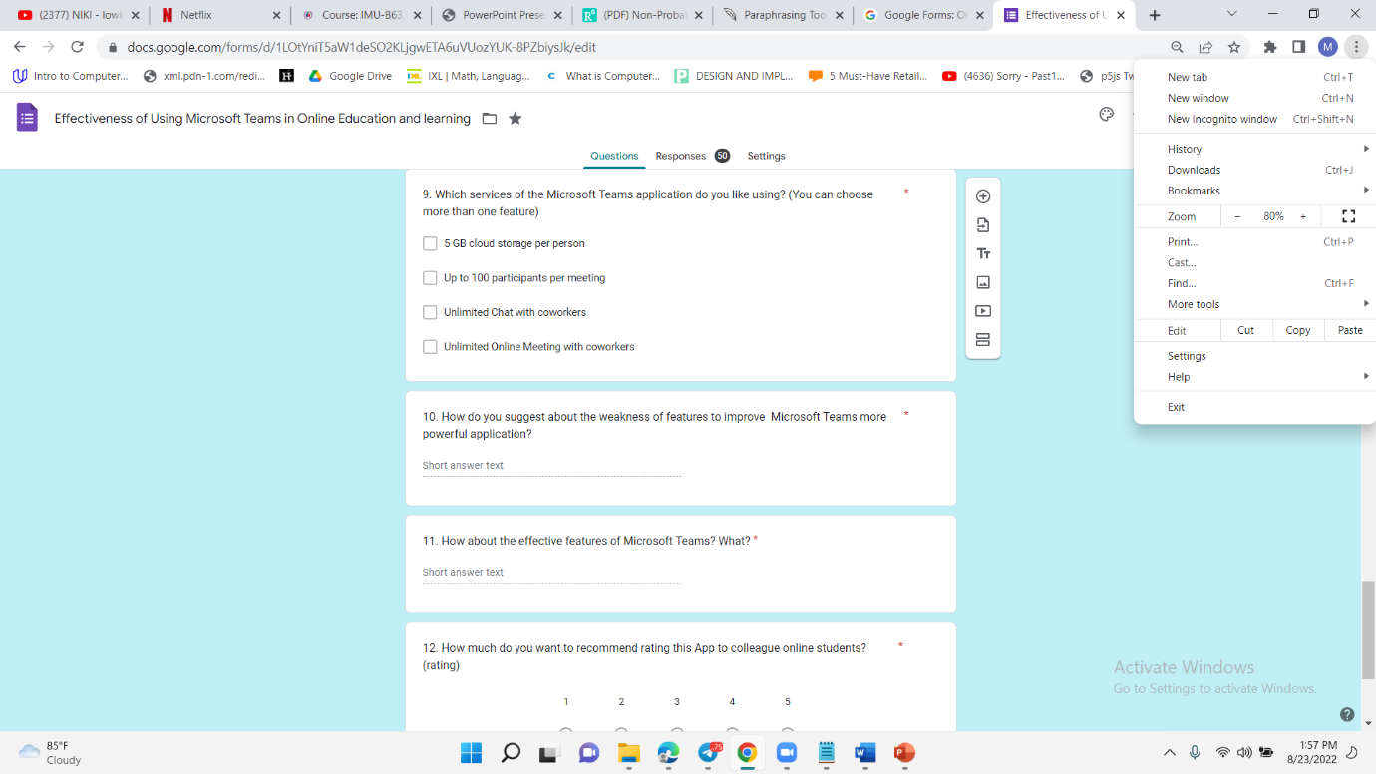
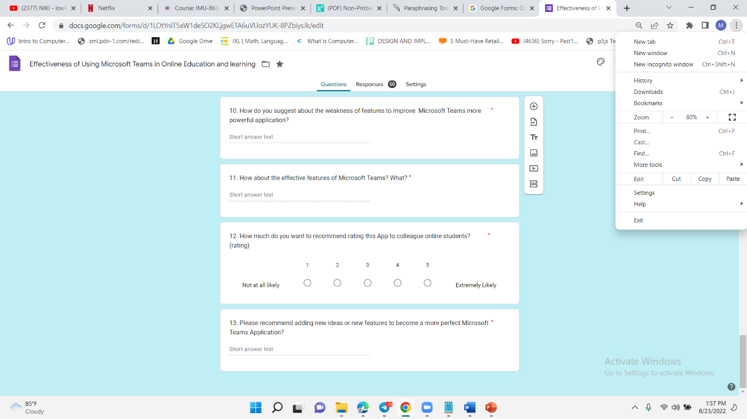
Survey Questions
Survey Questions 9 to 13

Slide 12
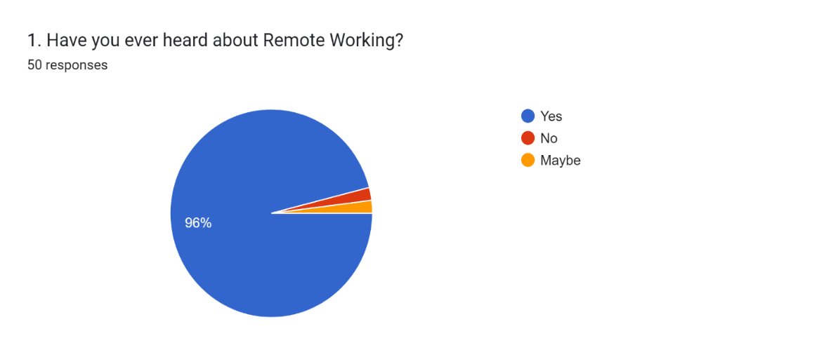
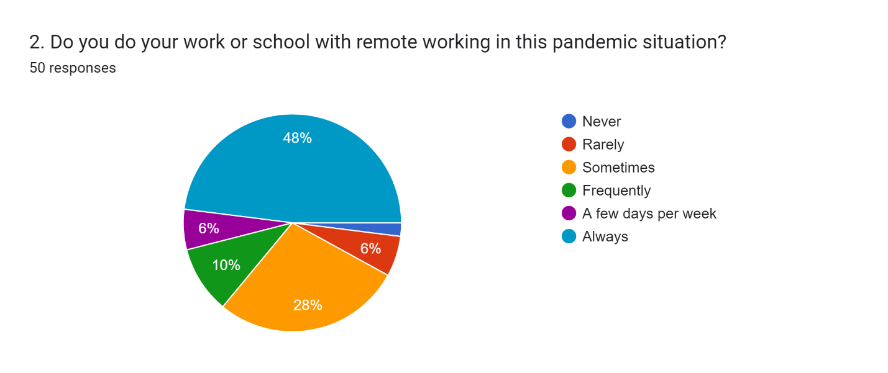
Survey Analysis Results
Q1: 96 % of people heard about Remote working and learning. So That result is good for my hypothesis.
Q2: 48% of people are always used for their school and work in this pandemic situation. That was also a good result for my hypothesis.

Slide 13
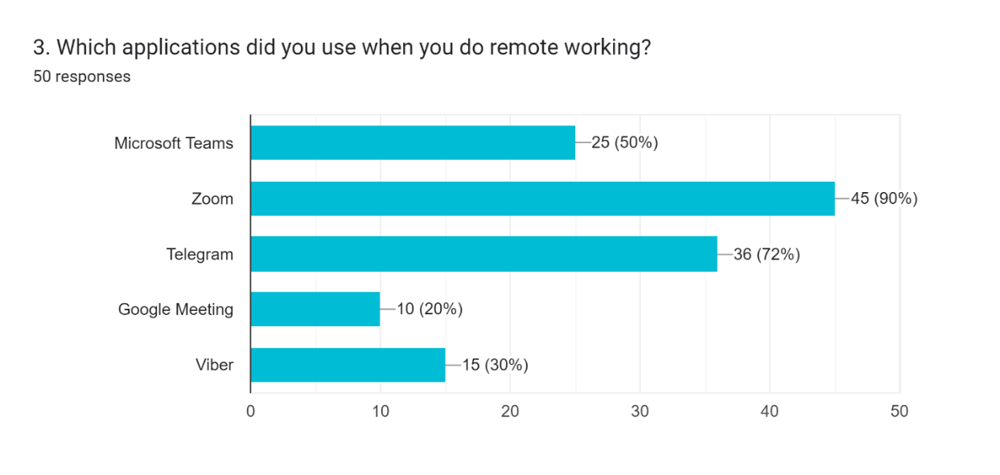
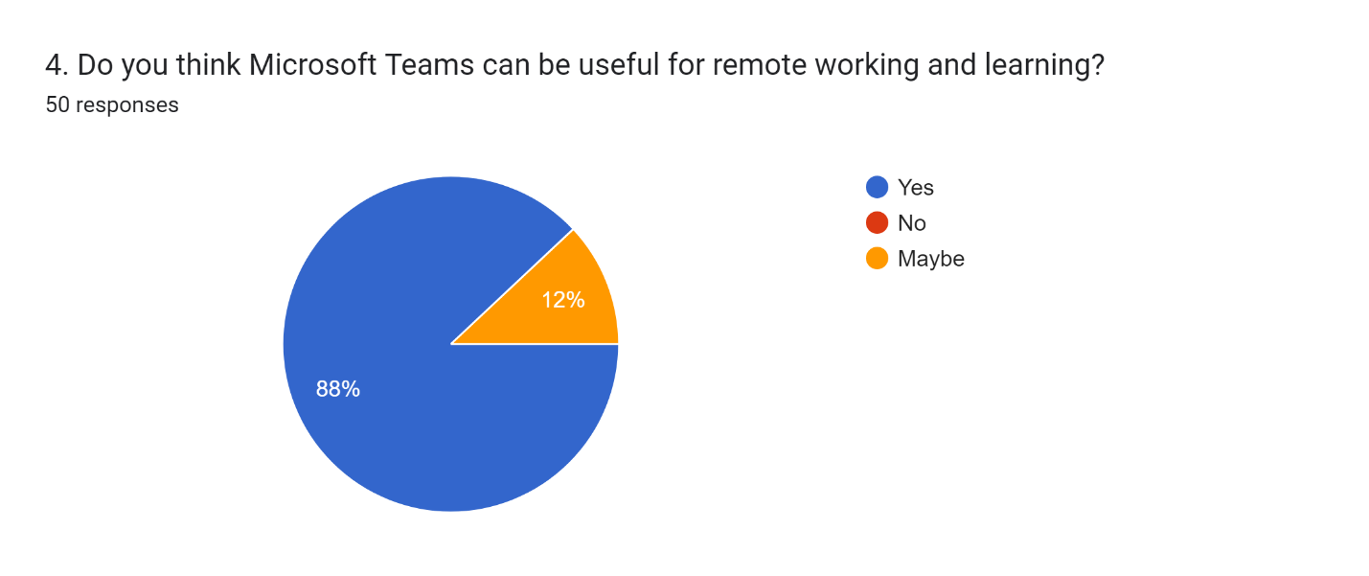
Survey Analysis Results
Q3:50% of people used when they do remote working and learning. So That result is also good.
Q4: 88% of people thought that the Microsoft team can be useful for remote working and learning.

Slide 14
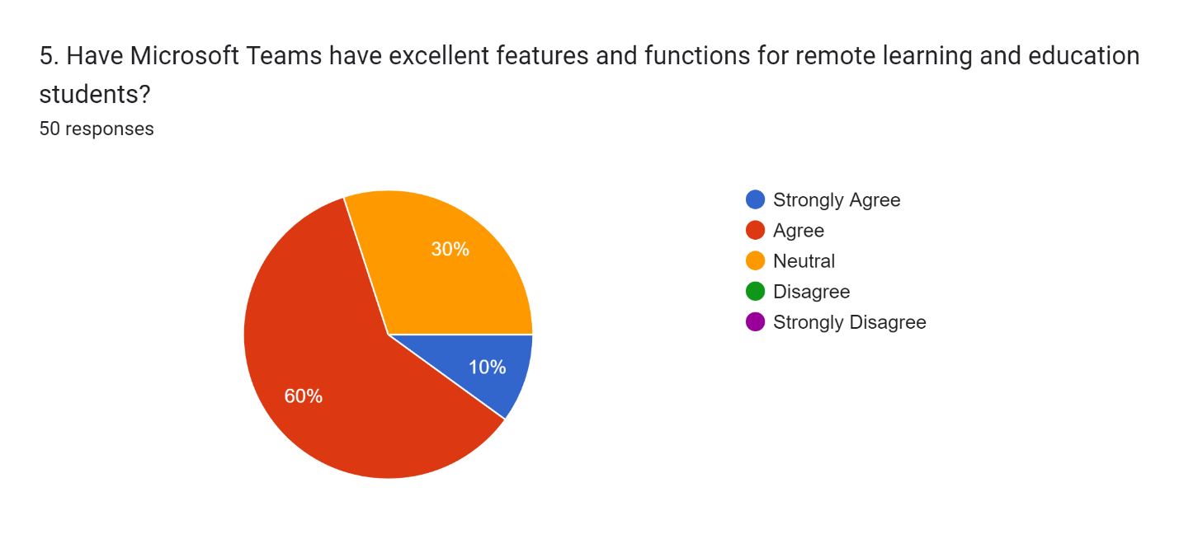
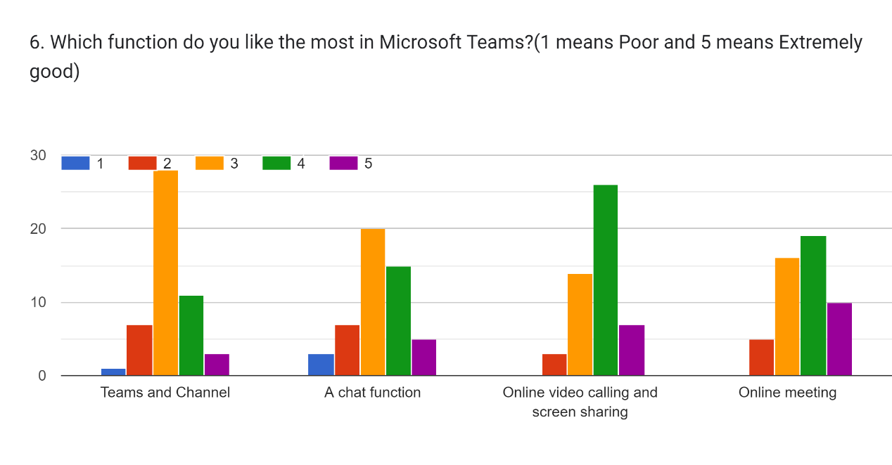
Survey Analysis Results
Q5: 60% and 10% answered agree and strongly agree that the Microsoft team have excellent features and functions for remote learning and education students.
Q6: they gave the over 50% in good for the features of Microsoft Teams.

Slide 15
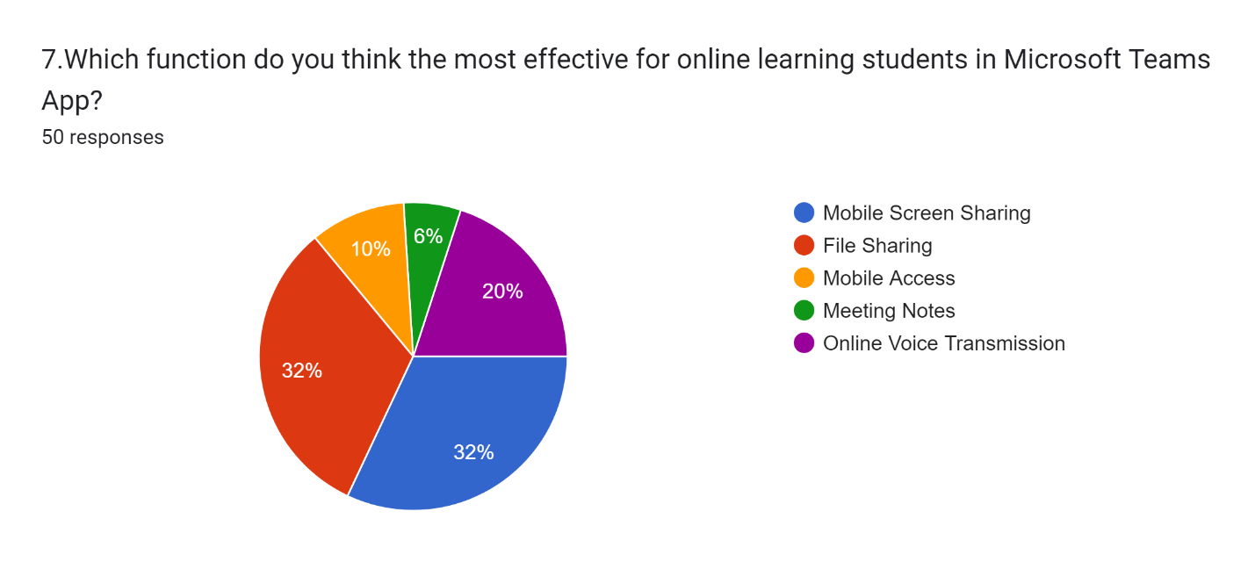
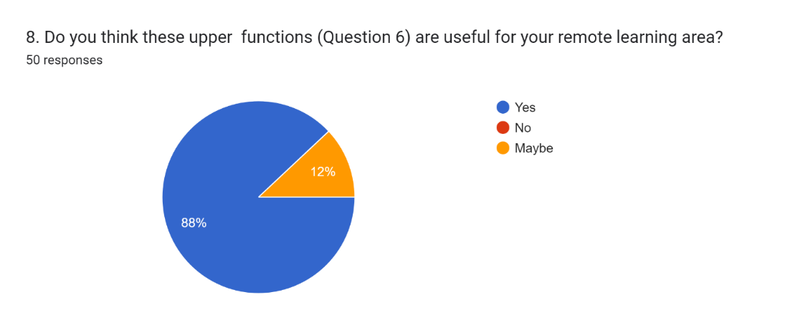
Survey Analysis Results
Q7: they thought File Sharing and Mobile sharing are the most effective function for online learning students in Microsoft Teams.
Q8: 88% of people thought that the upper functions are useful for remote learning areas.

Slide 16
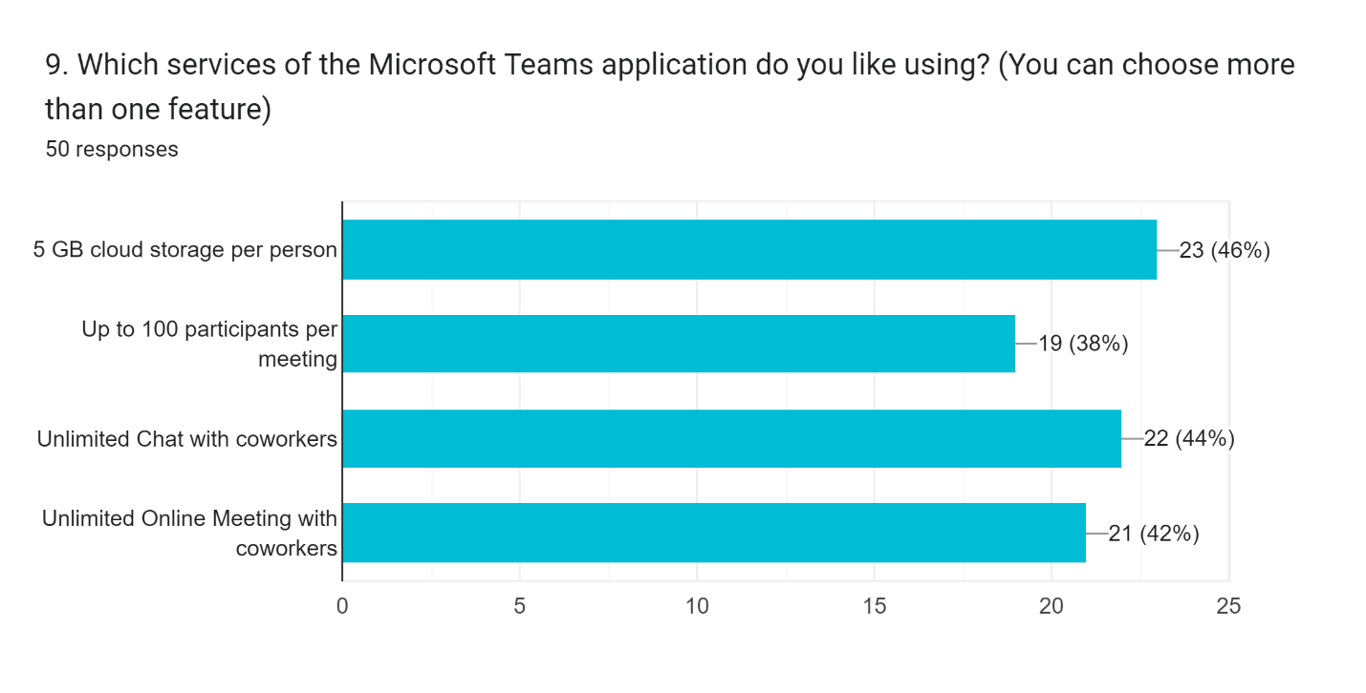
Survey Analysis Result
Q9: 46% of people liked the 5GB cloud storage per person service of Microsoft Teams

Slide 17
Survey Analysis Results
Q10: 56% of people give suggestions about the weak features to improve Microsoft Teams.
Q11:56% of people give suggestions about the effective features of Microsoft Teams.

Slide 18
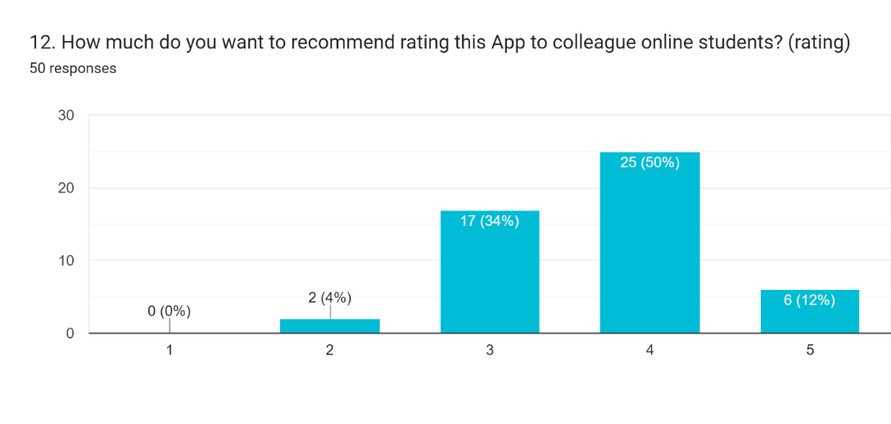
Survey Analysis Results
Q12:50% and 12% of people gave a good and excellent rating for this application to recommend to other colleague online students.
Q13: 48% of people gave new recommendations for this application.

Slide 19
Regression Analysis Results
Q5 (Y) | Agree | 4
Q6(X!) | Rating (1 to 5) | 5
The relationship between the Y and X1 variables is a significantly positive relationship. So, if X1 is increased and then Y also will be increased
For Y dependent variable relationship with X1( independent variable), the actual data value and predicted data value together meet on the trend line (x=5,y=4). In this scatter diagram , x=5 is answered rating number level 5 from 1 to 5 and y=4 is answered agree having excellent features and functions in Microsoft Teams.
According to the result of the relationship between Y and X1, the predicted value is (x=5, y=4) is meant that the Microsoft Teams application will be increased with more excellent features and functions using online meetings in the future.

Slide 20
Regression Analysis Result
Q5 (Y) | Agree
Q7(X2) | Mobile Screen Sharing
The relationship between the Y and X2 variables is significantly negative. So, if X2 is increased and then Y will be decreased
For Y dependent variable relationship with X2( independent variable), the actual data value and predicted data value together meet on the trend line (x=1,y=4). In this scatter diagram, x=1 is answered mobile screen sharing of this MT functions and y=4 is answered agree to have excellent features and functions in Microsoft Teams.
According to the result of the relationship between Y and X2, the predicted value is (x=1, y=4) is meant that the Microsoft Teams application will be increased with more excellent features and functions using mobile Screen Sharing in the future.

Slide 21
Result Outcomes
In this survey analysis, the outcome is matched with my hypothesis. Because most of them gave me the feedback that MT application was effective for online education and effectiveness
Most of this application’s users liked this app’s mobile screen sharing and online meetings.
My assumption (my alternative hypothesis) is correct and accepted.
There is a significant relationship between my hypothesis and alternative factors.

Slide 22
Conclusion
This research project may share the knowledge to knows from distance education to online education and give information on remote learning area
Online learners can investigate the features and function of the Microsoft Teams application
Online users can know the information on how effective Microsoft Teams application for online learning students
According to the finding result, the users can evaluate the strength and weaknesses of Microsoft Teams in the remote learning area.
This project Is a detailed about of Microsoft Teams features and functions.
Then the application is how much related to the remote working area.
The app is how effective for students on remote learning.

Slide 23
References
Teaching with Teams: An introduction to teaching an undergraduate law module using Microsoft Teams [Offline] Available From:
file:///C:/Users/Thet%20Htar/Downloads/188-745-1-PB.pdf [Accessed: 3.4.22]
Assessing The effectiveness of Microsoft teams during Covid 19 for Online Learning: A student’s perceptive [Offline] Available From:
file:///C:/Users/Thet%20Htar/Downloads/Assessing_the_effectiveness_of_Microsoft.pdf [Accessed: 12.4.22]
Teaching with Teams: Microsoft Teams Additional Features Quick Start Guide [Offline] Available From:
file:///C:/Users/Thet%20Htar/Downloads/Microsoft_Teams_Quickstart%20(1).pdf [Accessed: 24.4.22]
Education Blog [Online] Available From:
https://educationblog.microsoft.com/en-us/2020/10/3-teams-features-that-help-keep-online-classrooms-connected/ [Accessed: 7.5.22]

